Slide 1
Characteristics of Living Things

Slide 2
Life Functions
The processes of activities, common to all living things.
An organism is considered to be alive as long as its cells perform certain life functions.
  Nutrition
  Transport
  Respiration
  Excretion
  Regulation
  Growth
  Reproduction
  Synthesis
  Metabolism

Slide 3
Nutrition
A life process where an organism obtains (gets) and processes food.
Some organisms, such as green
plants, can make their own food.
  Autotrophs
Other living things must obtain
their food already formed.
  Heterotrophs

Slide 4
Nutrition
Food is taken in from the environment by ingestion.
Ingested food is not usually in a form that can be used by the body and must be changed into a usable form.

Slide 5
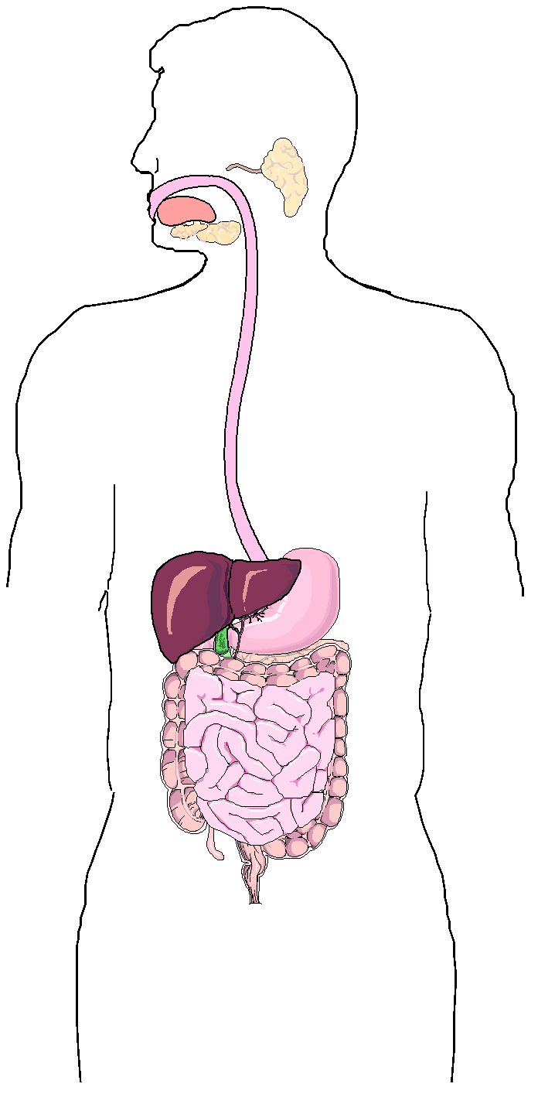
Nutrition
Digestion is the process that changes food into a form that can be used by the cell.
During digestion, large complex molecules are broken down into small simple molecules.

Slide 6
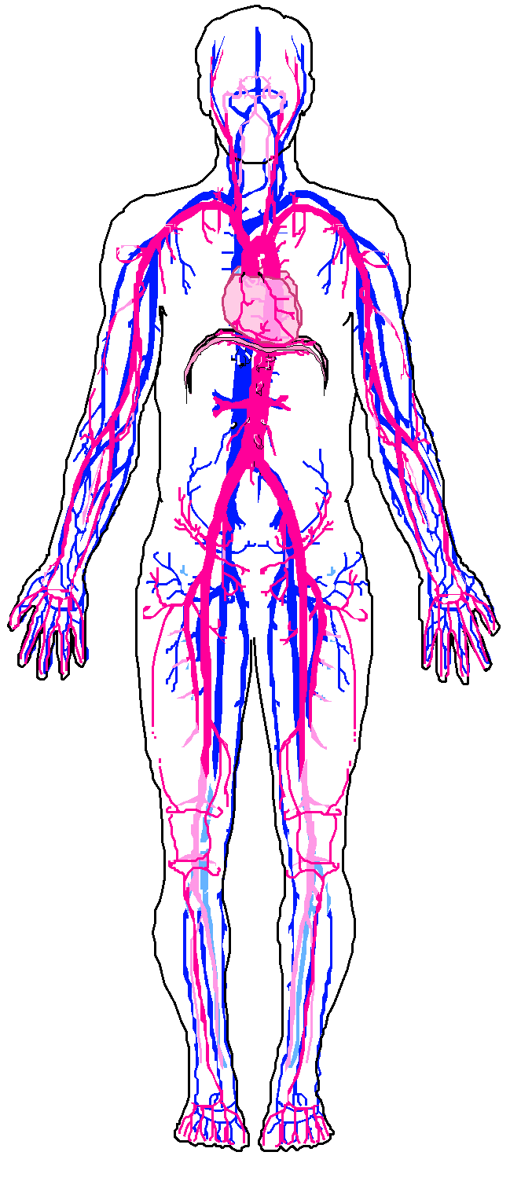
Transport
The life process involved with the circulation and absorption of nutrients.
  Nutrients are the parts of food that can be used by the cell.
The movement of materials within the cells or throughout an organism is circulation.

Slide 7
Transport
During absorption, usable materials are taken into the cell.
Along with nutrients, oxygen, water, and wastes are transported throughout a cell or organism.

Slide 8
Respiration
A complex series of chemical reactions that releases energy for life activities.
An organism’s energy is stored in food nutrients.
Most organisms need oxygen for respiration
  Aerobic Organism
A few organisms do not need oxygen for their respiratory processes.
  Anaerobic Organisms

Slide 9
Excretion
Life processes result in the formation of
cellular wastes.
These wastes are harmful to the organism
and must be removed.
Products commonly
excreted from cells are
carbon dioxide and water.
Egestion is the process that removes undigested materials from the body.
  Do not confuse the process of egestion (getting rid of solid wastes), with excretion (the elimination of gaseous or liquid wastes of cellular respiration).

Slide 10
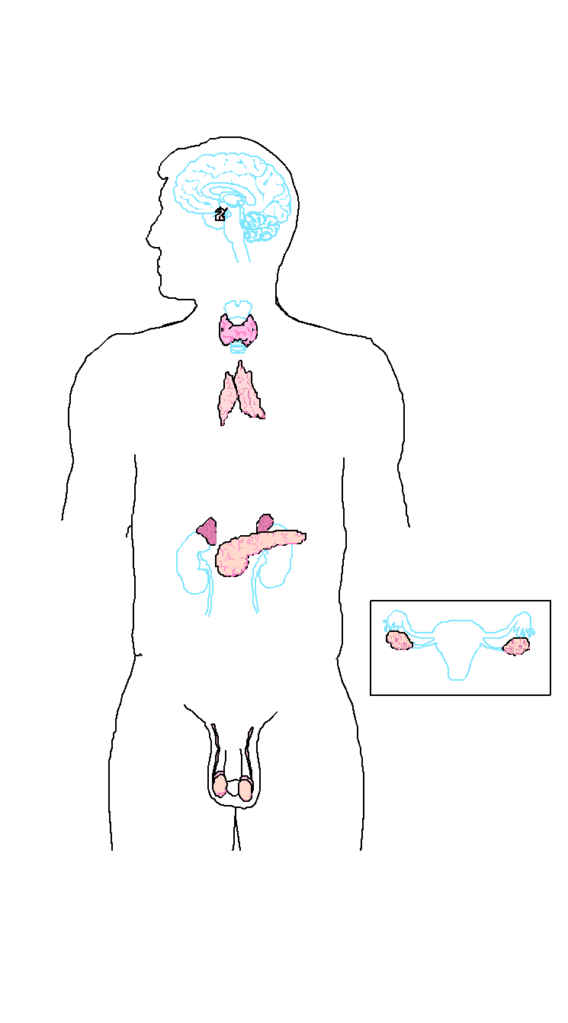
Regulation
The life activity responsible for the control and coordination of all the various activities of an organism.
The nervous and
endocrine systems
are responsible for
regulation.

Slide 11
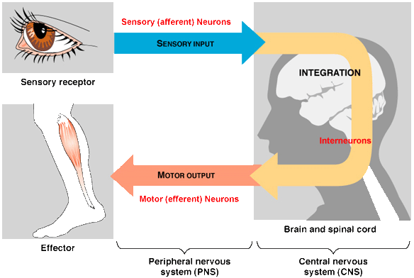
Regulation
Regulation allows organisms to respond to changes in the environment.
  They can find food, avoid danger, respond to light.
A change in the internal or external environment is known as a stimulus (light, temperature, etc).

Slide 12
Synthesis
Living things are able to produce complex substances from simple substances by the process of synthesis.
During this process, the simple food molecules produced during digestion are put together to make the complex materials needed by the organism.
  Example: During photosynthesis, green plants “make” complex compounds (sugar) from simpler materials.

Slide 13
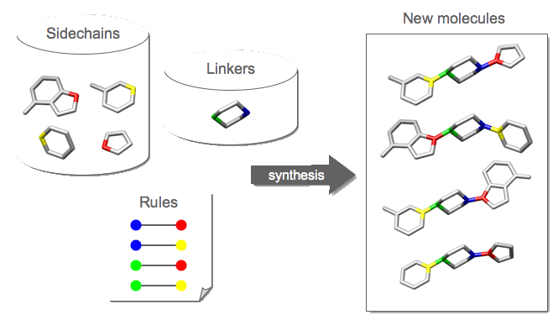
Synthesis

Slide 14
Growth
Growth results from synthesis.
Growth is an increase in size and/or number of cells of an organism.
The complex materials produced during synthesis are used for growth.
When cells grow, the size of the cytoplasm changes, but not the size of the nucleus.
Day 1
Day 5

Slide 15
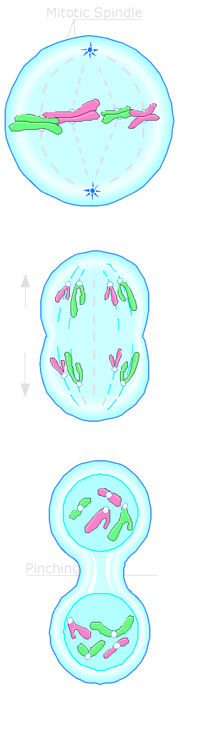
Reproduction
The production (making) of new organisms.
This is the only life process that is not necessary for the life of an individual organism.
It is necessary for the continued existence of a particular group of organisms.
Cells reproduce by cell division.
  Cell division involves a series of changes in the cell leading to the production of two new cells.
  In organisms made up of many cells, the production of new cells also results in the growth and repair of damaged tissues.

Slide 16
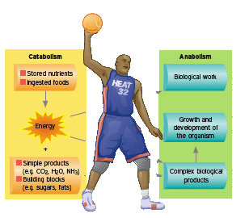
Metabolism
All the processes needed by an organism to maintain life are known as metabolism.
Metabolism is the total of all the processes taking place within
the cells of
an organism.

Slide 17
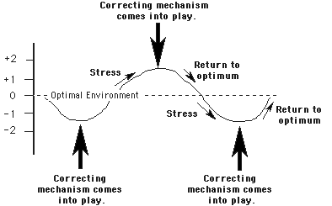
Homeostasis
The maintenance of a stable internal (inside) environment in spite of changes in the external (outside) environment is called homeostasis.
When the body is in homeostasis, it is in a balanced or “steady” state (condition).

